Slide 1
Database management systems (project)
Presentation by:
Saksham Rastogi
Samarjoy Pandit

Slide 2

Introduction
We have tried to implement offline book store system in which customers can buy books from this application.
We have built this application using Java(for Graphical User Interface) and MySQL(for the databases) and have connected them using JDBC.
This project is menu driven providing the facility of maintaining details of customers, books, publishers ,view payment receipt etc.

Slide 3

Features
Login Page: There is an option of logging in as user and administrator
The Project is divided into two parts:
Administrator Part
Customer Part

Slide 4

Administrator part
Add/Remove a Book
Change attributes a Book
Change edition
Change book name
Change price
Add/Remove a Publisher

Slide 5

Customer Part
Search a book
By Book Name
By Price
By Genre
Add/Remove Book from Cart
Can order books of his choice
Payment Processing

Slide 6
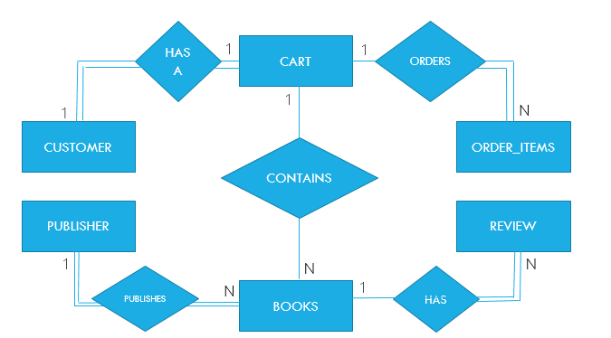
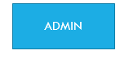
ER DIAGRAM

Slide 7
RELATIONAL SCHEMA
Books
ISBN | Book Name | Edition | Price | Description | Pages | Language | Genre | Pub_ID (F.K.) | Author Name
Publisher
ID | Name | Country | Email ID | Address
Customer
ID | Name | Address | Zip | Country | Phone | Email | Password
Order_Item
ID | Date | Cus_ID (F.K.) | Book_ISBN (F.K.) | Item_Price | Quantity

Slide 8
Relational schema(contd.)
Cart
Book ISBN | Cus_ID (F.K.) | Edition | Price | Description | Pages | Language | Pub_ID | Genre | Book Name | Author Name
Review
Book_ISBN (F.K.) | Cus_ID (UNIQUE) | Date | Rating | Comment
Admin
ID | Name | Email | Password

Slide 9
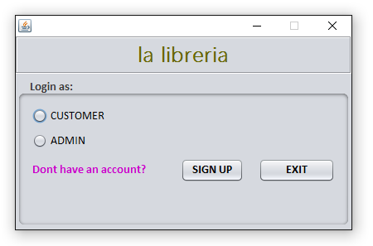
lOGIN page
The User is required to login into the application either as a customer or an admin. If you are new to it, and don’t have an account, there is an option available as “SIGN UP”.

Slide 10
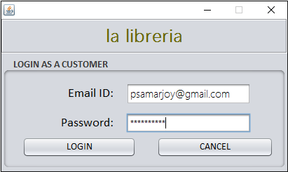
CUSTOMER lOGIN
The login page for the customer accepts the email id and the password for the customer and checks it from the one in the database. Thus it allows only the authenticated person to enter the application.

Slide 11
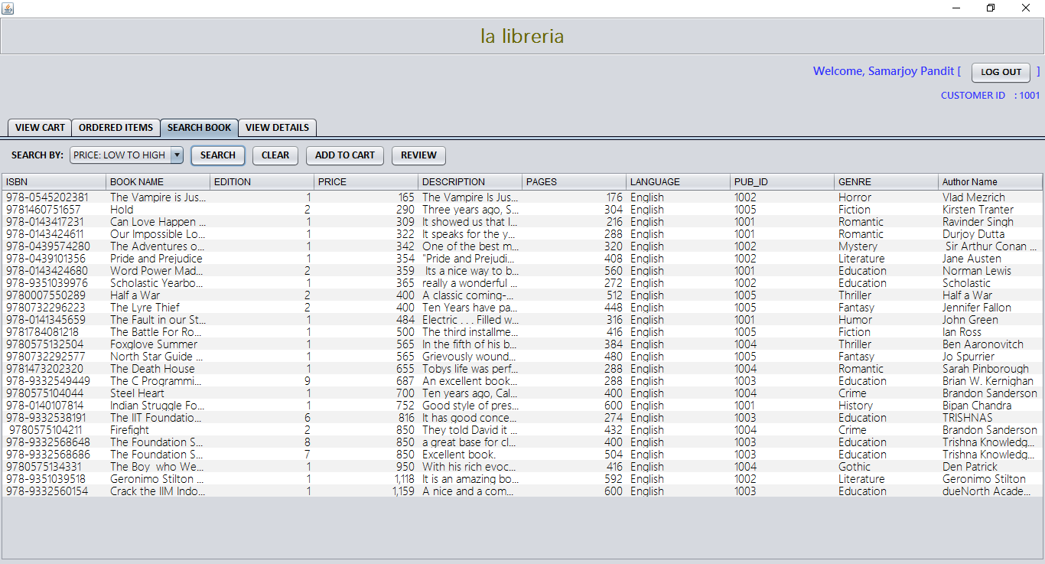
Customer options
Once logged in as the customer, the page with features for the customer arrives.

Slide 12
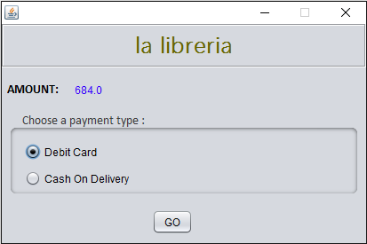
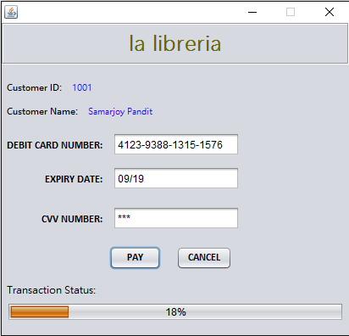
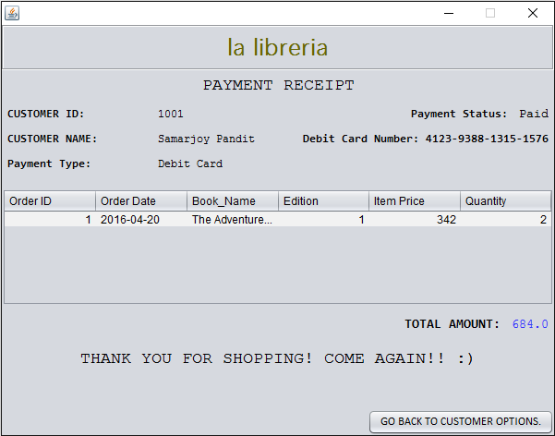
Payment process
After a customer is done adding books to cart and has ordered an item, payment process begins.

Slide 13
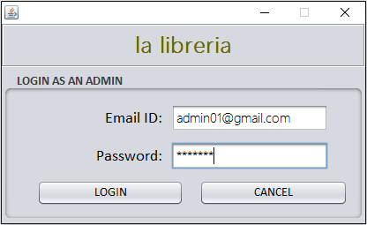
Admin login
Same as the customer login, the admin login page also takes email and password as input from the user and allows only the authenticated admins to make changes.

Slide 14
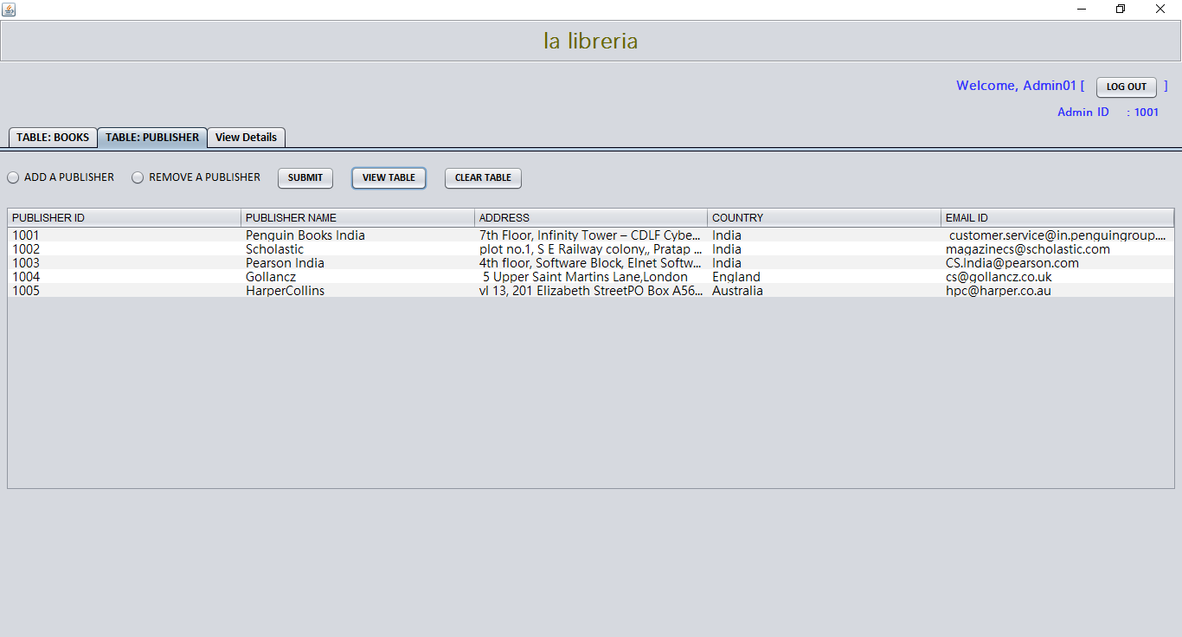
Admin options
After logging in as the admin, the page with possible options for the admin can be seen.

Slide 15
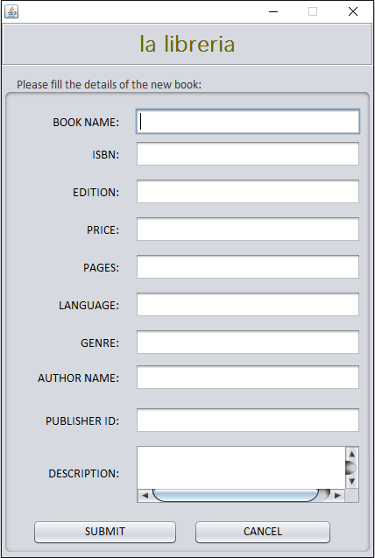
OTHER FRAMES FROM THE PROJECT
The new book frame is a sub part of the Admin Options frame.
It takes input the details of the book and stores it into the database.

Slide 16
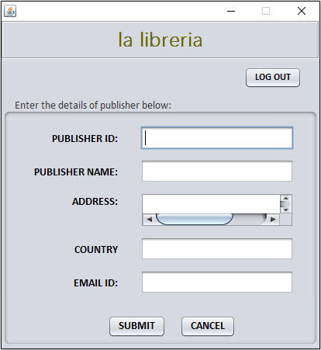
OTHER FRAMES FROM THE PROJECT(contd.)
We have selected a few publishers for our bookstore. But if we need or want to add another one, there is an option available to add a publisher.

Slide 17
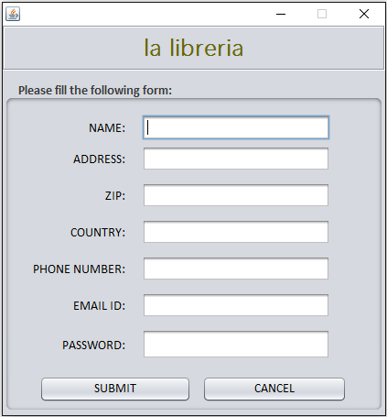
OTHER FRAMES FROM THE PROJECT(contd.)
If you are not a customer, you can sign up!
Just fill in the details and your information will be stored in the database!

Slide 18
“EXECUTION VIDEO”

Slide 19
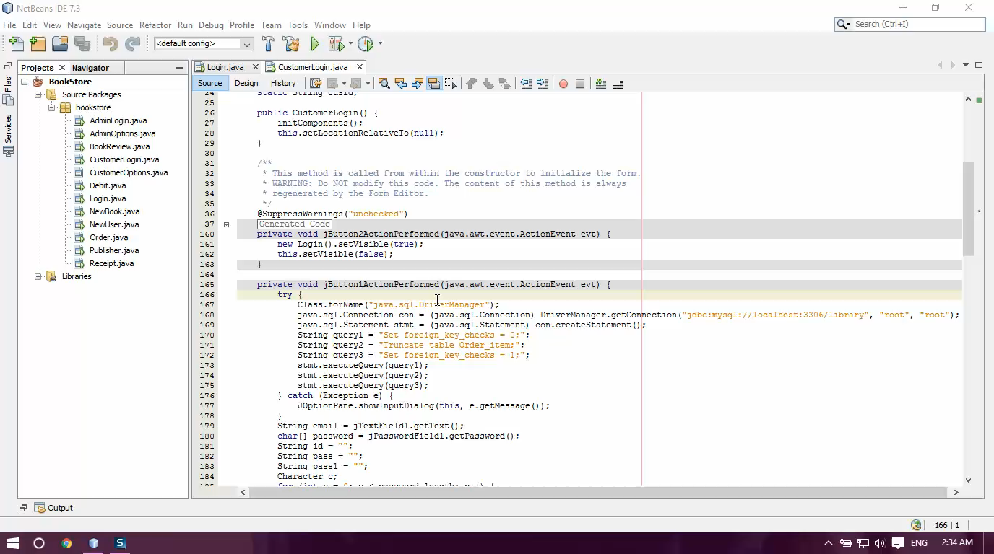

Slide 20
THANK YOU !

